Slide 1


BlackRock Investment Analysis
Weekly status report 5

Slide 2
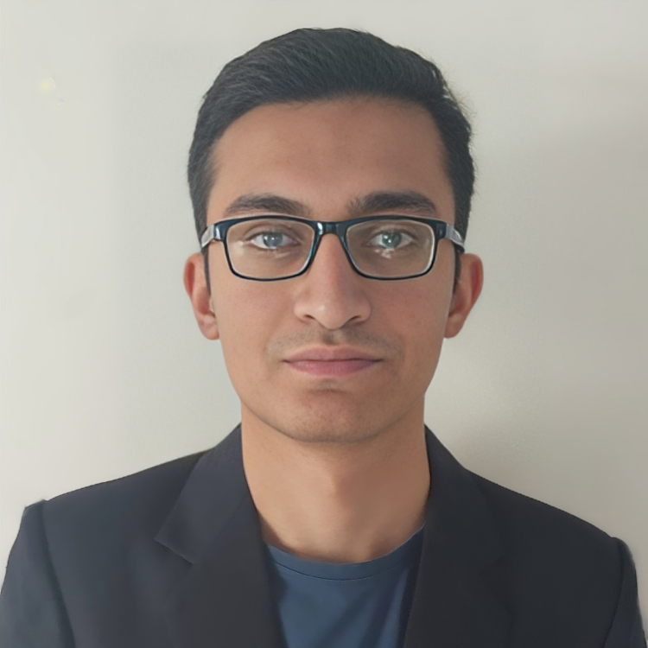
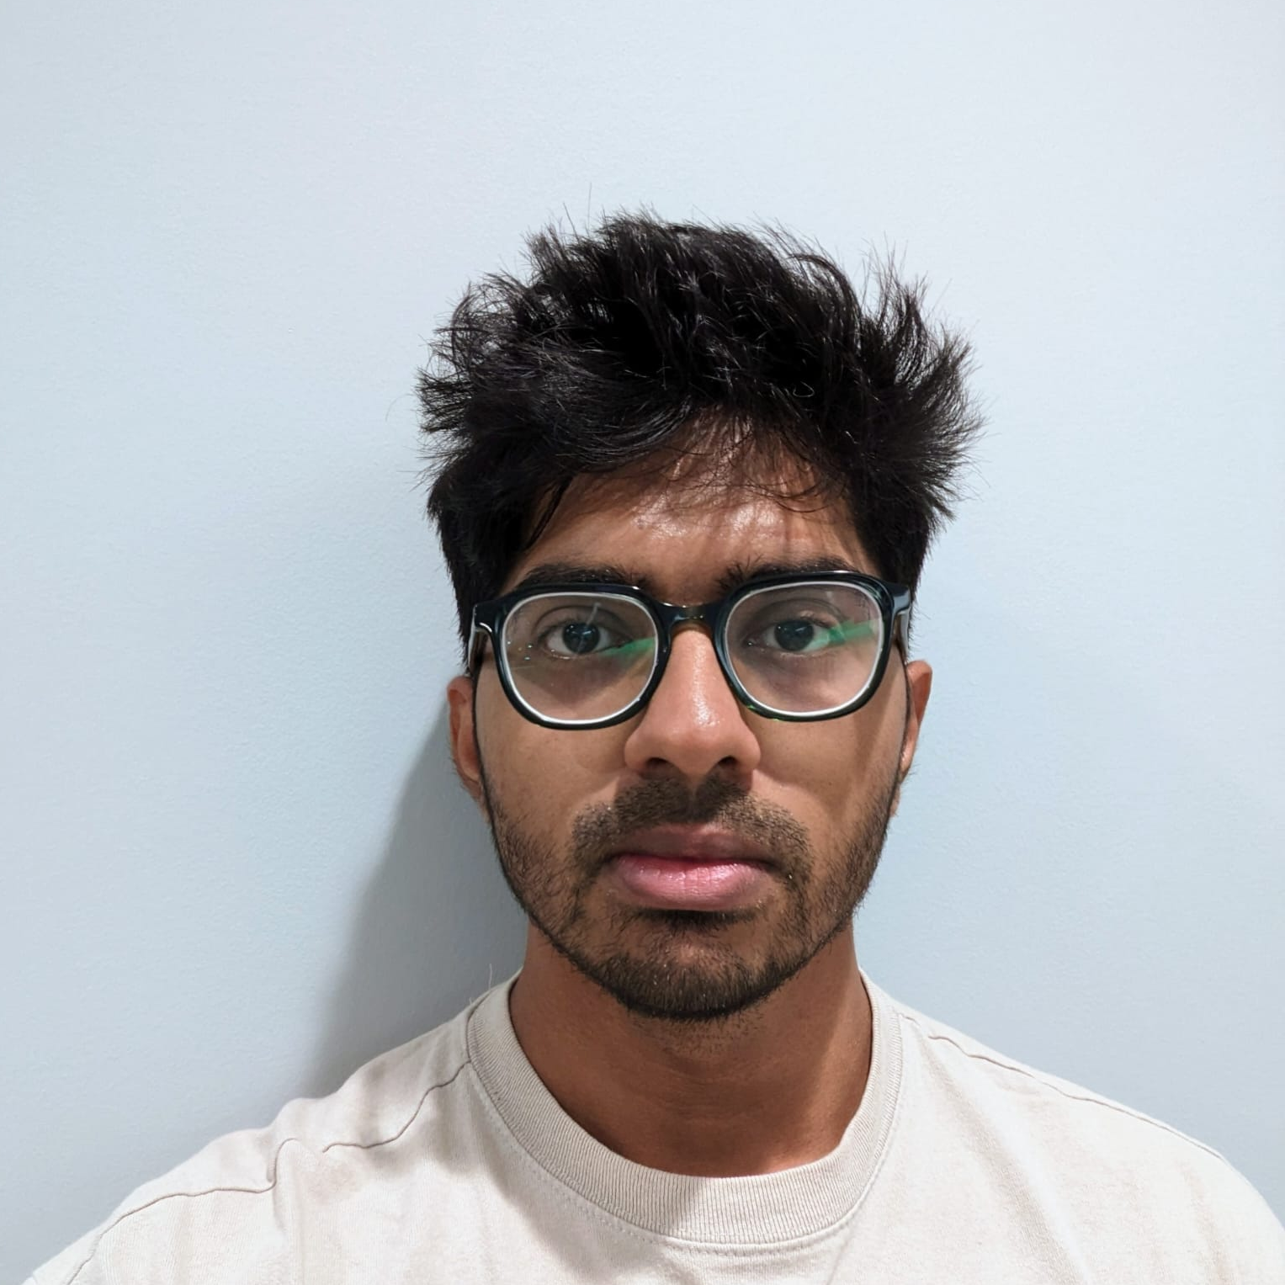
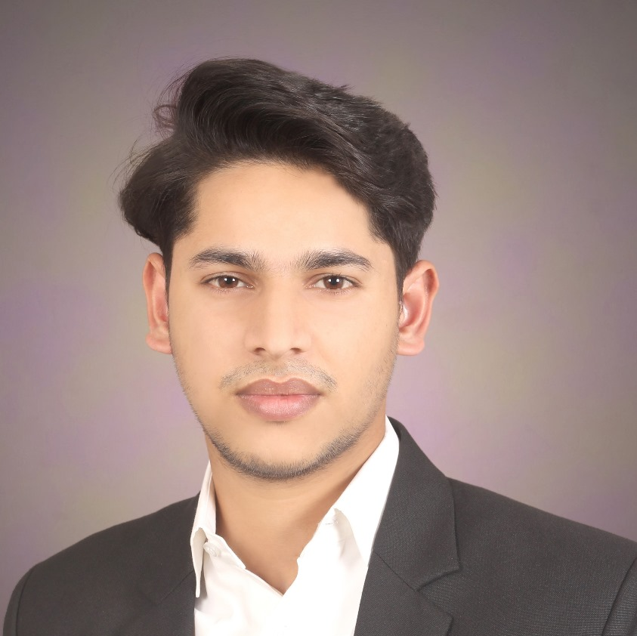
Team Members
Aryan Radadiya
Developer
Joyson Gonsalves
Team Lead
Sumit Kumar Pandey
Data Analyst

Slide 3
Date of Report: 13th February 2024
Date of Last Report: 6th February 2024
Prepared By: Group 7
Project Status: Delay

Slide 4

Activities Since Last Report
Issues or Challenges encountered this week:
Facing issues in coding Predictive modeling.
What was done to overcome them:
We are searching for references and understanding how the machine learning model works.

Slide 5
Activities Since Last Report
Task completed this week:
Designed how the dashboard will look/rough design.

Slide 6



Communication
We had a phone conversation regarding the project progress and how we are going to proceed.

Slide 7

Activities to be completed before next week
Testing the Machine learning model.
Solving the errors of this week.

Slide 8


Thank You Any Questions?

